Slide 1
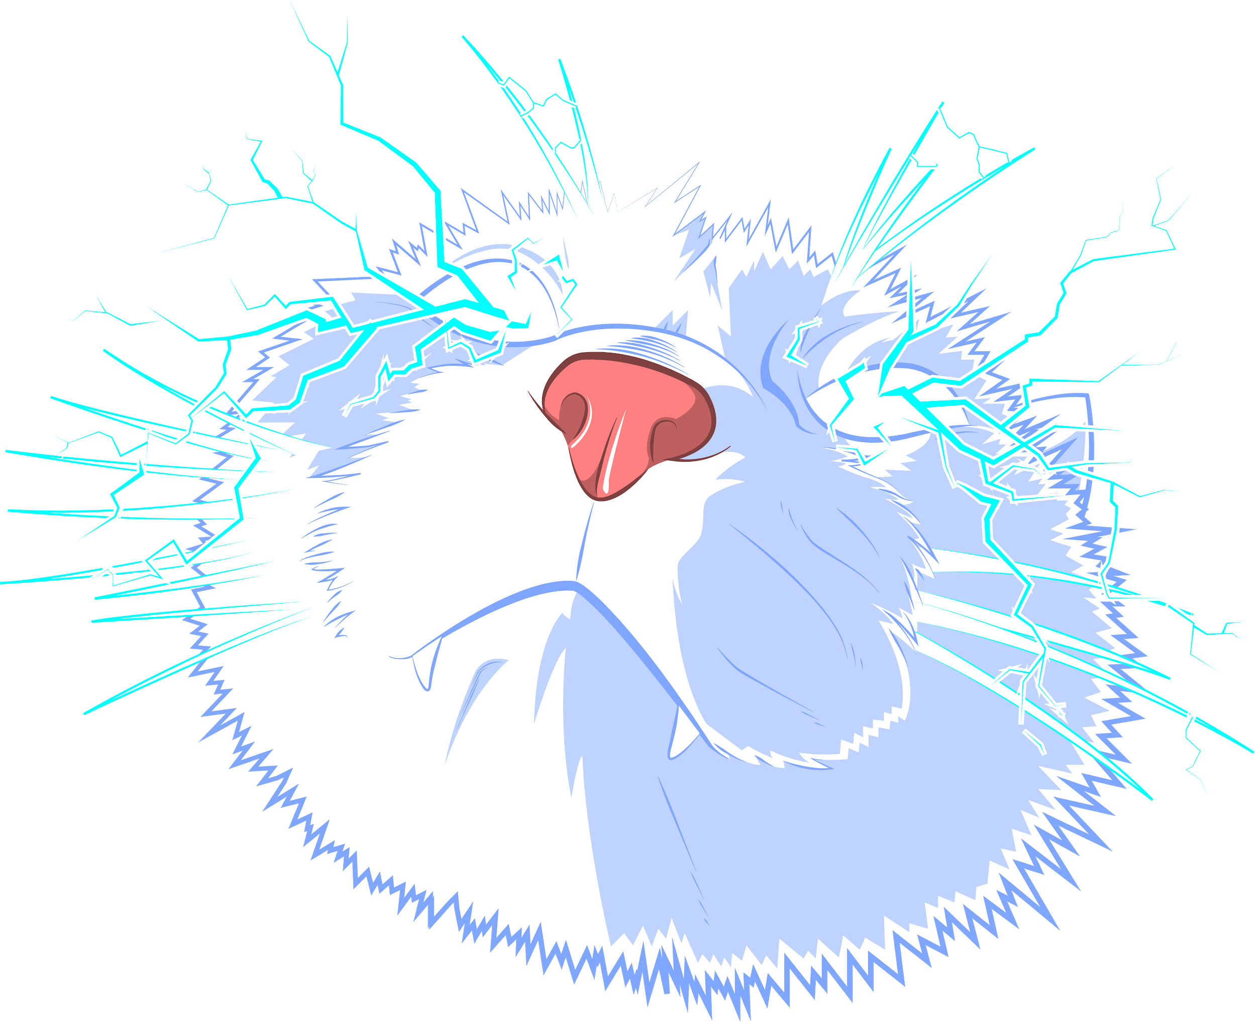
Clustering Techniques Applied to Lightning Data
Team Squeem
Notes:
Ben

Slide 2
Quick Introduction
Alex Herrera, Ben van Oostendorp, Aeon Williams
Dr. Jeremy Thomas, Dr. Natalia Solorzano
Dr. Banabas Bede, Dr. Yilin Wu

Slide 3
The Data and Visualization

Slide 4
The Structure of the Data
The WWLLN data that we used for this project is collected from all around the world. It is a ground based network that detects the return strokes of the lightning. The processed data contains the latitude, longitude, energy, how many stations detected it, and a few other metrics.
The GLM data might be used in the future contains a lot more data, but is mostly limited to the Western Hemisphere. It detects events with a camera-like sensor, and then groups those events into groups, and then into flashes. It contains all of the same data as the WWLLN data, but a lot more such as area, duration, etc.
There is also microwave data that we have yet to use from the Naval Research Lab. There’s 2 sets, GMI 89 GHz and SSMIS 91 GHz.
Notes:
Ben

Slide 5
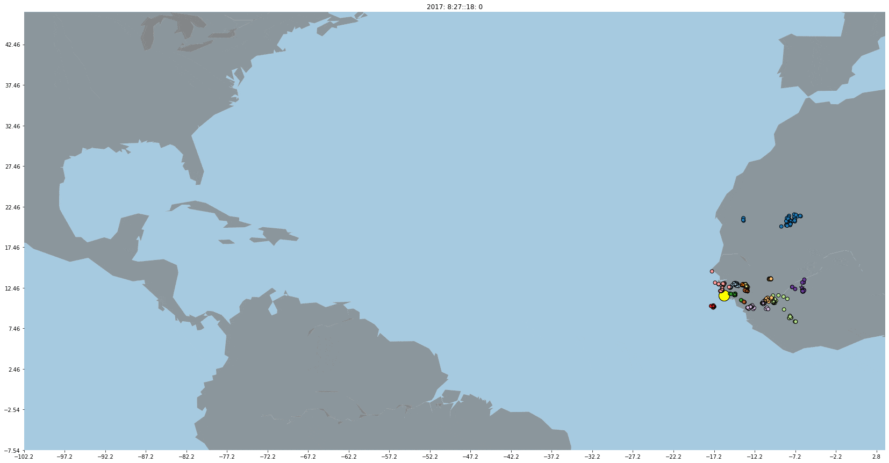
Visualization

Slide 6
The Techniques

Slide 7
Quick Refresher on Techniques
Clustering is the grouping of data points into “clusters” based on different parameters. Commonly, the idea is to reduce the dissimilarity of data points to cluster centers, typically through minimizing distances from the center to the data points.
The algorithms we use are K-Means, DBSCAN, and Fuzzy C-Means.
Notes:
Ben 1-7

Slide 8
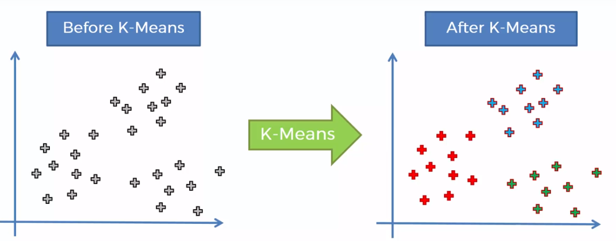
KMeans
KMeans is an unsupervised data clustering algorithm. With a predetermined number of clusters, 2 random centroids are placed, and each data point is allocated to the nearest centroid, forming the clusters. This is repeated, with the centroids moving to the location of the average points in their cluster, until maximum iterations is reached (arbitrary and pre-determined), or until the clusters stop moving.

Slide 9
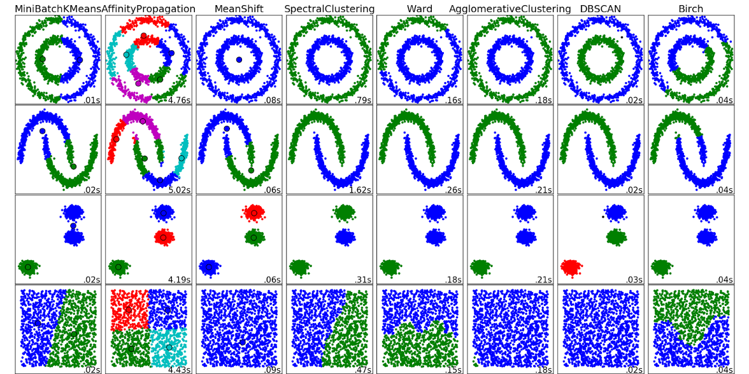
DBSCAN
DBScan (Density-Based Spatial Clustering of Applications with Noise) is a density-based clustering algorithm. The key fact of this algorithm is that the neighbourhood of each point in a cluster which is within a given radius (the epsilon) must have a minimum number of points (min_samples). This algorithm has proved extremely efficient in detecting outliers and handling noise.

Slide 10
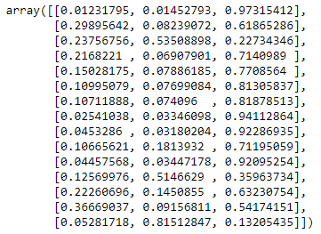
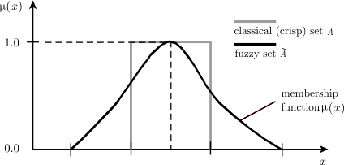
Fuzzy C-Means (FCM)
Fuzzy C-Means is a lot like K-Means in which it partitions the data into clusters, with the center of each cluster being the mean of every data point in the cluster. The algorithm minimizes the distance of each point to each centroid.
Instead of defining each data point as being a binary “in” or “out” of a cluster, it instead has a membership rating to each cluster, ranging from 0 to 1.

Slide 11
Now the Question: Which method best reflects what we expect in the real world?
Notes:
Ben

Slide 12
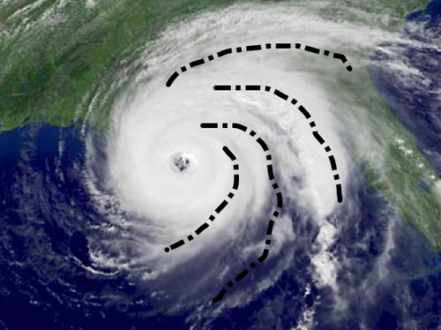
What do we expect in the real world?
Clusters of lightning should roughly reflect the structure of clouds and rain bands, in that there will be a curved structure while also being close together. Especially when it comes to tropical cyclones, the structure of the clusters should mimic their appearance.
Notes:
Ben

Slide 13
Comparing Each Algorithm

Slide 14
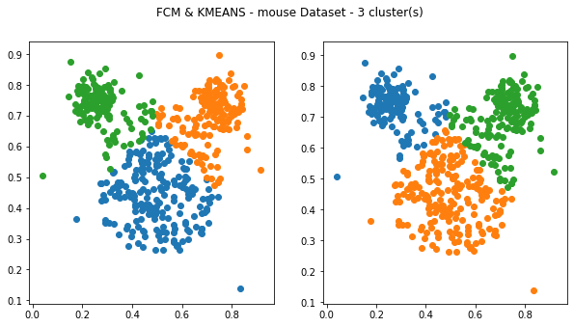
KMEANS and FCM
0% similarity

Slide 15
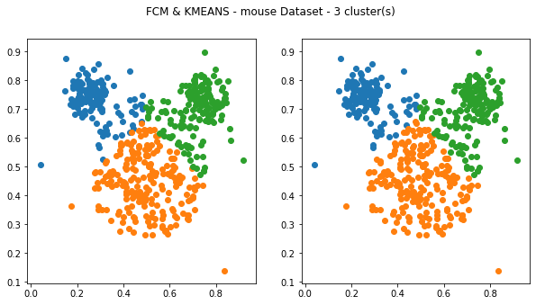
KMEANS and FCM
98.8% similarity

Slide 16
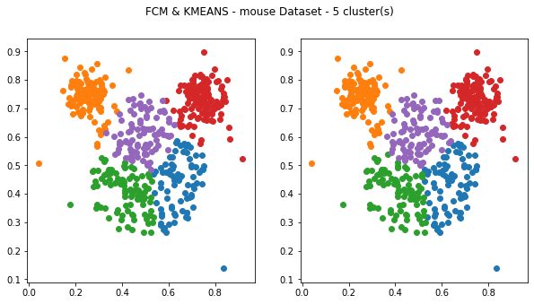
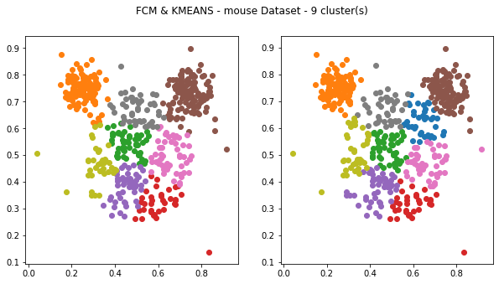
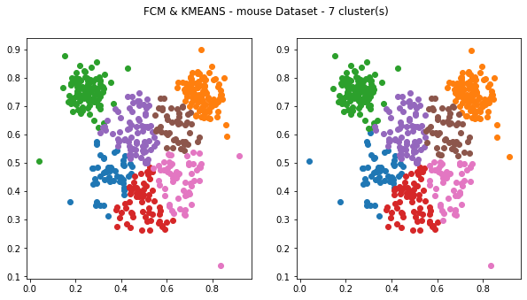
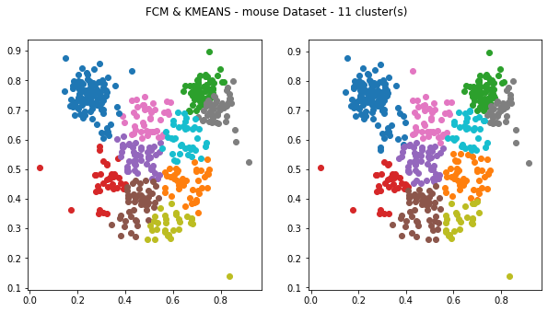
KMEANS and FCM

Slide 17
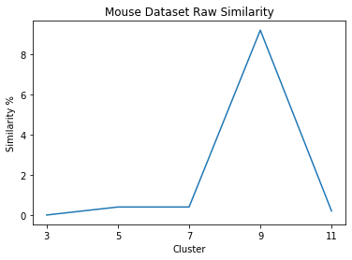
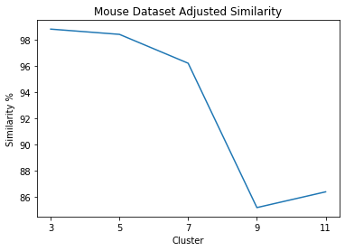
KMEANS and FCM

Slide 18
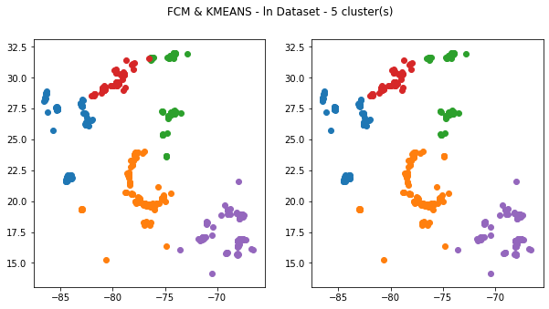
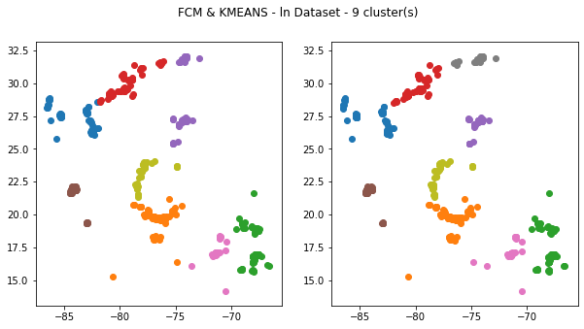
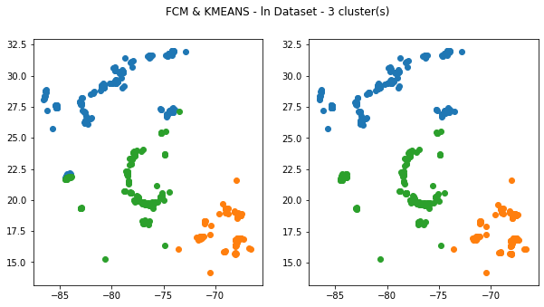
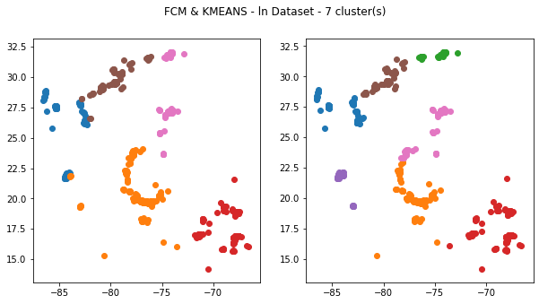
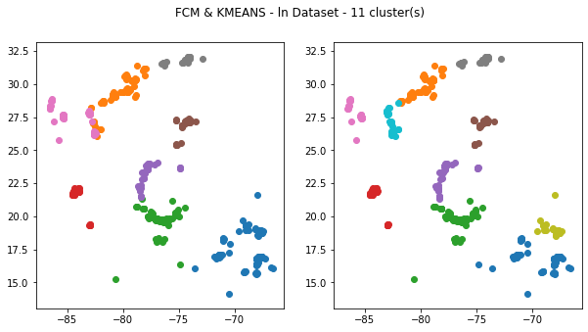
KMEANS and FCM

Slide 19
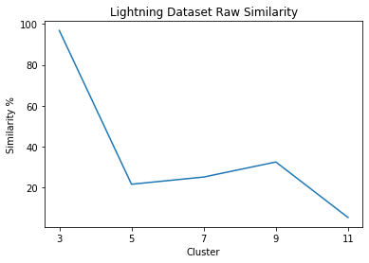
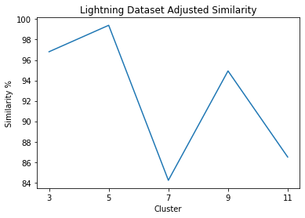
KMEANS and FCM

Slide 20
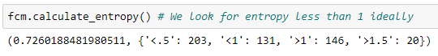
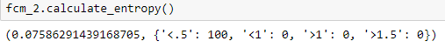
KMEANS and FCM
Both algorithms produce extremely similar cluster results
Similarity consistently lowers with cluster count
FCM computation time is 5,303.98% slower than KMeans (4.1 minutes vs 47 milliseconds)
FCM is still good for entropy calculations of multidimensional data

Slide 21
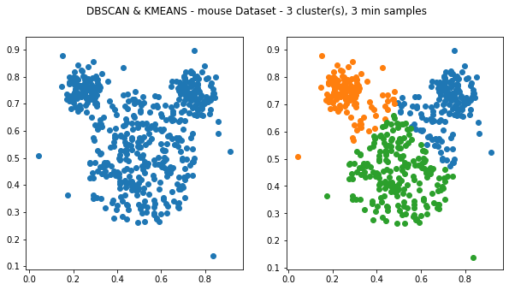
KMEANS and DBSCAN
As expected for the mouse dataset used as an example, KMEANS does a better job with data that forms spherical or convex in shape, identifying three shaped regions.
With three easily identifiable clusters, feeding the algorithm k=3 has great results.

Slide 22
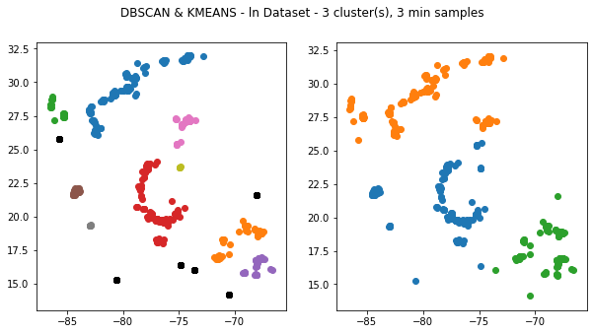
KMEANS and DSBCAN
But as expected, DBSCAN is better at density connected regions and irregular shapes, like the rainbands of a storm.
Can identify and handle outliers easily.
Less “spherical” shaped regions.

Slide 23
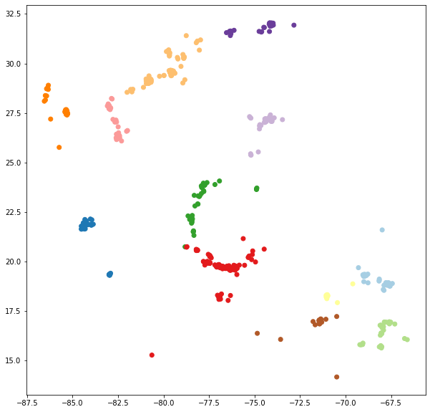
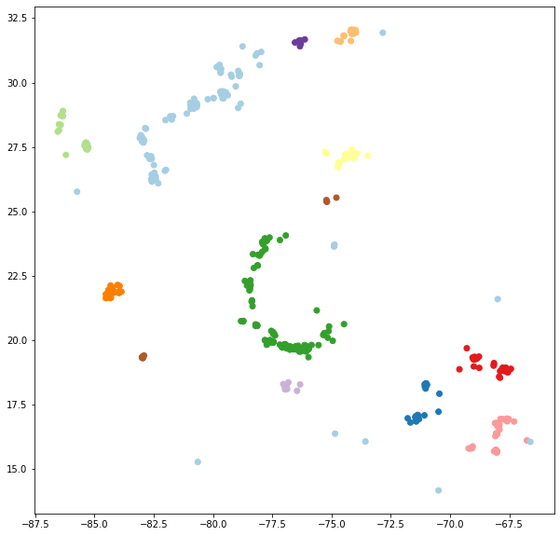
FCM and DSBCAN
The differences between FCM and DBSCAN are pretty similar to Kmeans and DBSCAN, however FCM does still maintain the advantage of being able to tell if the clusters are very separated from each other. In terms of performance, DBSCAN outperforms FCM when it comes to visualization. However, the two can be made to perform very similarly (with enough tweaking).
DBSCAN
FCM

Slide 24
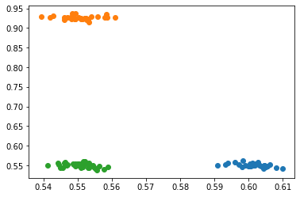
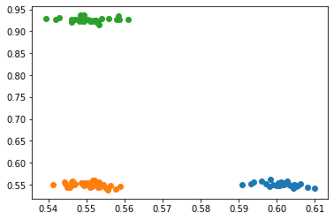
FCM and DBSCAN

Slide 25
The conclusion

Slide 26
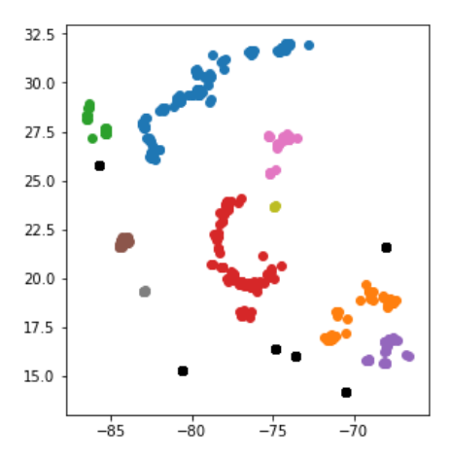
DBSCAN yields the best results
DBSCAN best emulates the real world with having the best structure of rainbands and clouds. It doesn’t run into the issue of having spherical clusters which lets it have the curved bands that we typically see in storms. It also lets us deal with noise, which in the case of lightning strikes/strokes, can be clouds/storms that only have a single strike or stroke.
Notes:
Alex

Slide 27
Where we can go in the future with this?

Slide 28
What we can continue to do with this knowledge
The first thing that’s very close to what we have would be utilizing the GLM data. Clustering it and comparing with WWLLN data could be informative of better accuracy for cloud location.
Another aspect could be investigating the clusters on the microwave data and images that WWLLN also has to better inspect tropical cyclones.
We could also search for lightning cluster patterns that would help predict storm intensity and formation.
Notes:
Aeon

Slide 29
Thanks! Any Questions?

Slide 30
References
Hutchins, M. L., Holzworth, R. H., & Brundell, J. B. (2014). Diurnal variation of the global electric circuit from clustered thunderstorms. Journal of Geophysical Research: Space Physics, 119(1), 620-629. https://agupubs.onlinelibrary.wiley.com/doi/pdf/10.1002/2013JA019593
Solorzano, N. N., Thomas, J. N., & Holzworth, R. H. (2008, January). Global studies of tropical cyclones using the World Wide Lightning Location Network. In Proceedings of the AMS 2008 meeting, New Orleans, LA, USA
https://wwlln.net/publications/Solorzano_AMS_29FEB2008.pdf
B Bede - Mathematics of Fuzzy Sets and Fuzzy Logic, Springer, 2013
https://link.springer.com/chapter/10.1007/978-3-642-35221-8_12

